Slide 1

Analysis of Use Cases: Asynchronous vs Parallel Programming
Shreyash Bhardwaj (MSRCASC)
Shilpa Nayak , Professor, (MSRCASC)
Notes:
Good afternoon Esteemed Judges and my fellow Scholars,
My name is Shreyash Bhardwaj, and I am here to share insights from my research paper titled "Analysis of Use Cases: Asynchronous vs Parallel Programming."
ffffff

Slide 2
INDEX
Abstract
Introduction
Key Differences
Methodology
Results & Analysis
Conclusion
Notes:
Ladies and gentlemen, Today, I stand before you to delve into the intricate world of software development, where the pursuit of performance optimization is an ever-present challenge . As our software systems evolve, so do the demands placed upon them - demands for responsiveness, scalability, and efficiency. In this pursuit, two paradigms have emerged as pillars of strength: asynchronous and parallel programming

Slide 3
ABSTRACT
Software systems evolution poses the challenge of balancing performance optimization with responsiveness and scalability, prompting the exploration of asynchronous and parallel programming paradigms.
The paper conducts a thorough analysis of these paradigms across various use cases, assessing their effectiveness in meeting performance objectives and navigating the complexities of modern software systems.
It begins by defining asynchronous and parallel programming paradigms, highlighting their key differences and typical application scenarios.
The analysis delves into specific use cases where each paradigm demonstrates proficiency, including web server applications, real-time systems, and data processing pipelines.
Through a comparative study, the paper elucidates the tradeoffs associated with each approach, focusing on factors like concurrency control, resource utilization, and code maintainability, aiming to offer practical guidance for programmers in selecting the most suitable paradigm for their scenarios.
Notes:
Imagine a world where every task, every operation, is seamlessly executed without delay. That is the promise of asynchronous programming - a paradigm where tasks run independently, allowing our systems to remain responsive even when faced with heavy workloads.

Slide 4
INTRODUCTION
Optimization of performance, responsiveness, and scalability is crucial in software development.
Asynchronous and parallel programming paradigms offer effective strategies to address this challenge.
It explores their fundamental principles, application scenarios, and comparative advantages across various use cases.
By highlighting tradeoffs in concurrency control, resource utilization, and code maintainability, the research aims to guide developers in selecting the appropriate programming paradigm for their projects.
Real-world scenarios, including web server applications, real-time systems, and data processing pipelines, are systematically examined to provide practical guidance for optimizing performance in modern software systems.
Notes:
On the other hand, we have parallel programming, a powerhouse of performance optimization. Picture a team of workers tackling a monumental task together, dividing the workload and conquering it in record time. That's the essence of parallelism - harnessing the collective power of multiple processors to execute tasks concurrently, maximizing throughput and efficiency.
But how do we choose between these paradigms? That's where our journey takes a deeper dive into real-world scenarios.

Slide 5
METHODOLOGY
Methodology Overview for Evaluating Asynchronous and Parallel Programming Paradigms:
Literature Review: Comprehensive review of academic papers, books, and technical documentation to understand foundational concepts and best practices.
Use Case Selection: Identify diverse use cases representing different domains and scenarios where these paradigms are commonly used, considering system requirements and performance goals.
Data Collection: Gather relevant data for selected use cases, including system specifications and performance metrics, through conducting experiments.
Implementation and Experimentation : Implement asynchronous and parallel versions of selected use cases, design experiments to evaluate performance under various conditions, and measure key metrics such as execution time and resource utilization.
Analysis and Comparison: Analyze experimental results to identify trends and tradeoffs, compare performance across different use cases, and draw conclusions on the suitability of each paradigm for specific scenarios.
Notes:
Our methodology encompasses an extensive literature review to understand the core concepts of asynchronous and parallel programming, followed by the selection of diverse use cases based on system requirements and performance goals. We gather relevant data, including system specifications and performance metrics, by conducting experiments. Implementing asynchronous and parallel versions of selected use cases allows us to evaluate their performance under different conditions, measuring key metrics like execution time and resource utilization. Finally, through rigorous analysis of experimental results, we identify trends and trade-offs, enabling us to draw conclusions about the suitability of each paradigm for specific scenarios.

Slide 6
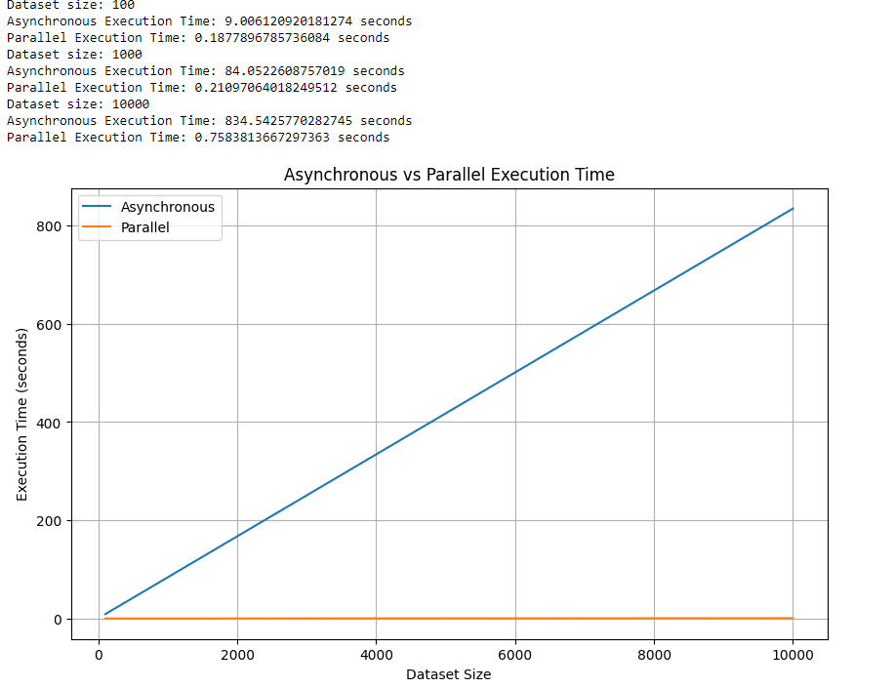
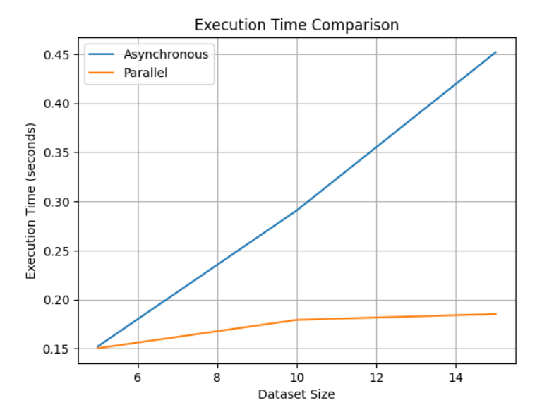
RESULTS AND ANALYSIS
CPU Bound Operation
A CPU-bound operation relies heavily on the processing power of the CPU for execution. Its performance is primarily limited by the speed and capabilities of the CPU, rather than other system resources like memory, disk I/O, or network bandwidth. Examples : Mathematical Calculation, Image and Video Processing, Compilation etc.
Program 1: One Second Delay
Program 2: Fibonacci Sequence
Notes:
These are tasks that heavily rely on the processing power of the CPU. Here, parallel programming shines like a beacon of efficiency, breaking down tasks into smaller, independent units of work that can be executed concurrently, maximizing CPU utilization and minimizing execution times.

Slide 7
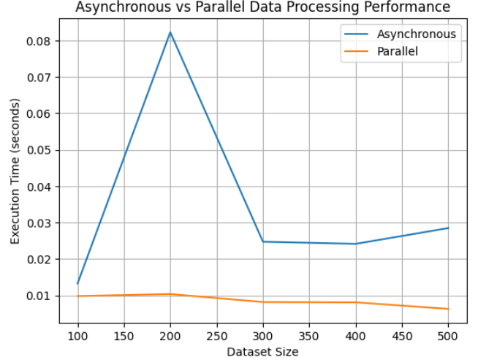
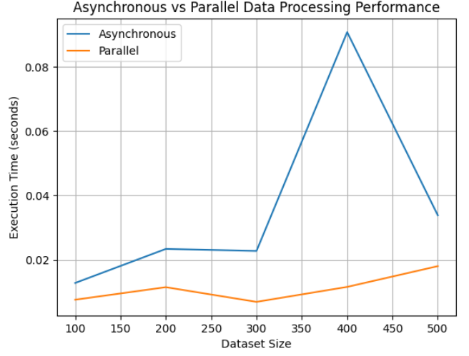
Data Processing
Data processing involves transforming raw data into actionable insights through operations such as organization, sorting, filtering, aggregation, analysis, and summarization. To determine the most appropriate paradigm for these tasks, two separate code implementations were developed for comparison.
Program 1: Multiplication Operation
Program 2: Square Root from Dataset
Notes:
Next, we venture into the realm of data processing, where the efficiency of our algorithms can make or break our systems. Once again, parallel programming emerges as the victor, demonstrating its superiority in manipulating and transforming data efficiently, paving the way for actionable insights and informed decisions.

Slide 8
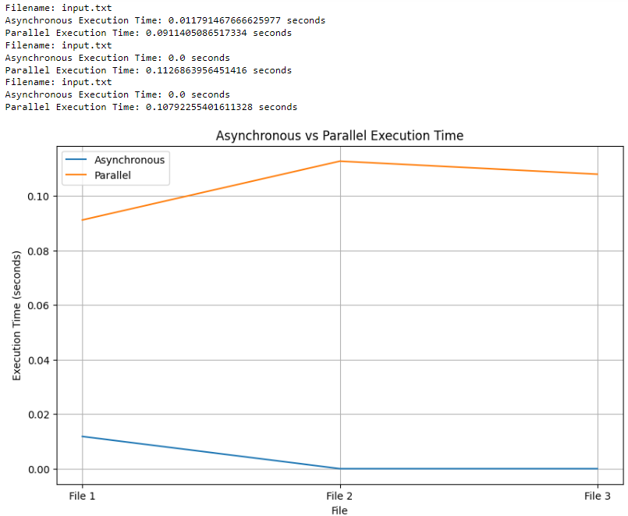
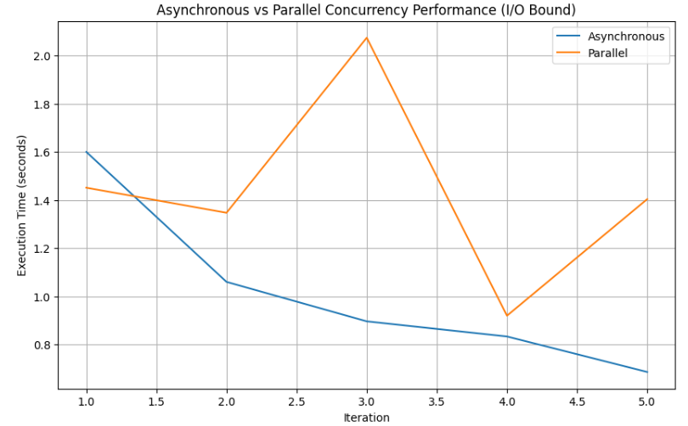
IO-Bound Operation
An I/O-bound operation primarily waits for input/output operations to complete, rather than actively using the CPU for computation. This limitation is determined by the speed of input/output devices like disk drives, network connections, or user input/output interfaces. To identify the most suitable paradigm for handling such operations, two separate code implementations were created for comparison.
Program 1: File Transformation
Program 2: Image Retrieval
Notes:
But what about tasks that are bound by input/output operations? Here, the story takes a different turn. Asynchronous programming takes the spotlight, optimizing performance for I/O-bound operations by efficiently managing tasks that await input/output operations, minimizing idle time and maximizing throughput.

Slide 9
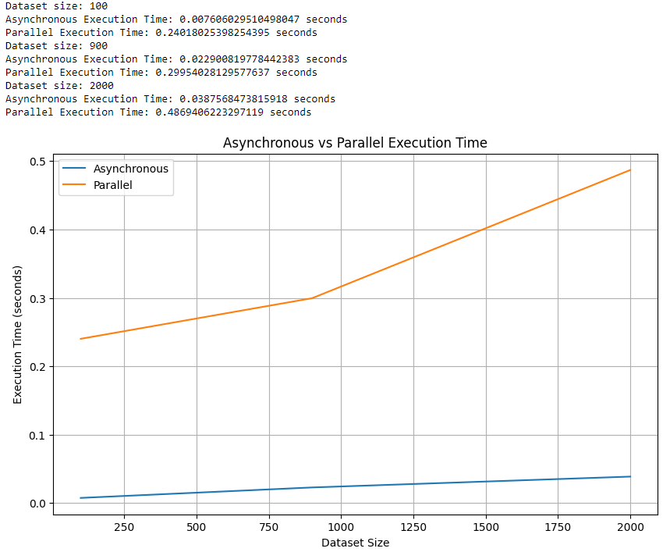
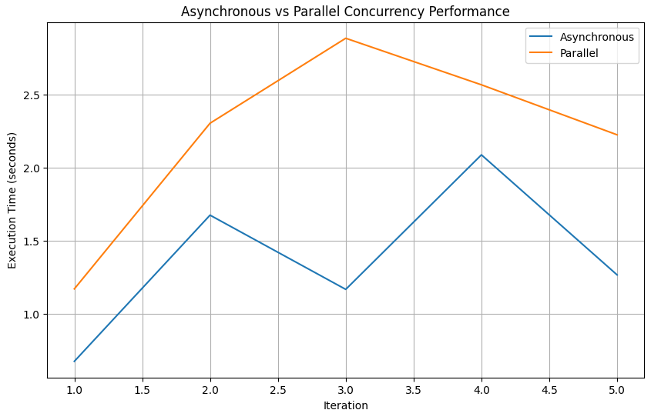
Concurrency
Concurrency involves a system's ability to handle multiple tasks or processes simultaneously, optimizing resource utilization and improving performance. While both asynchronous and parallel programming paradigms support concurrency, the aim was to assess their suitability. Two programs were created to compare their effectiveness in managing concurrency.
Program 1:Squaring Values
Program 2: Fetch Data From Web
Notes:
And let's not forget about concurrency - the backbone of modern software systems. Asynchronous programming, with its ability to handle multiple tasks concurrently without creating new threads for each task, proves to be the champion in resource utilization and scalability, offering enhanced performance and responsiveness in the face of concurrency-intensive tasks.

Slide 10
CONCLUSION
The research conducted a thorough analysis of asynchronous and parallel programming paradigms in diverse use cases, highlighting their strengths and tradeoffs in optimizing performance and managing complexities in modern software systems.
Insights from real-world scenarios and empirical experimentation were synthesized to provide practical guidance for developers in selecting the appropriate programming paradigm.
Factors such as concurrency control, resource utilization, and code maintainability were considered when determining the suitability of each paradigm.
The research emphasizes the importance of continued exploration of emerging technologies and methodologies to refine performance optimization strategies.
Ultimately, the goal is to empower developers to design more efficient and scalable software systems, thereby driving innovation and progress in the field of software engineering.
Notes:
In conclusion, the choice between asynchronous and parallel programming paradigms is not a binary one; it's a nuanced decision that depends on the nature of the task at hand. By understanding the strengths and trade-offs of each paradigm, we empower ourselves to make informed decisions that drive innovation and progress in the field of software engineering.
As we continue our journey in the dynamic realm of software development, let us embrace the power of asynchronous and parallel programming paradigms, harnessing their capabilities to create software systems that not only meet but exceed the expectations of our users.

Slide 11
THANK YOU
Notes:
Thank you.

